Slide 1
Global Initiative for Asthma (GINA) What’s new in GINA 2020?
This slide set is restricted for academic and educational purposes only. No additions or changes may be made to slides. Use of the slide set or of individual slides for commercial or promotional purposes requires approval from GINA.

Slide 2
COVID-19 and asthma (as at April 3, 2020)
Advise patients with asthma to continue taking their prescribed asthma medications, particularly inhaled corticosteroids (ICS), and oral corticosteroids (OCS) if prescribed
Asthma medications should be continued as usual. Stopping ICS often leads to potentially dangerous worsening of asthma
For patients with severe asthma: continue biologic therapy, and do not suddenly stop OCS if prescribed
Make sure that all patients have a written asthma action plan with instructions about:
Increasing controller and reliever medication when asthma worsens
Taking a short course of OCS for severe asthma exacerbations
When to seek medical help
See the GINA 2020 report for more information about treatment options for asthma action plans.
Avoid nebulizers where possible
Nebulizers increase the risk of disseminating virus to other patients AND to health care professionals
Pressurized metered dose inhaler via a spacer is the preferred treatment during severe exacerbations, with a mouthpiece or tightly fitting face mask if required

Slide 3
COVID-19 and asthma (as at March 30, 2020)
Avoid spirometry in patients with confirmed/suspected COVID-19
Spirometry can disseminate viral particles and expose staff and patients to risk of infection
While community transmission of the virus is occurring in your region, postpone spirometry and peak flow measurement within health care facilities unless there is an urgent need
Follow contact and droplet precautions
Follow strict infection control procedures if aerosol-generating procedures are needed
For example: nebulization, oxygen therapy (including with nasal prongs), sputum induction, manual ventilation, non-invasive ventilation and intubation
World Health Organization (WHO) infection control recommendations are found here: www.who.int/publications-detail/infection-prevention-and-control-during-health-care-when-novel-coronavirus-(ncov)-infection-is-suspected-20200125
Follow local health advice about hygiene strategies and use of personal protective equipment, as new information becomes available in your country or region

Slide 4
Other resources for COVID-19 (as at March 30, 2020)
Information for health professionals
World Health Organization (WHO) recommendations for infection control www.who.int/publications-detail/infection-prevention-and-control-during-health-care-when-novel-coronavirus-(ncov)-infection-is-suspected-20200125
Centers for Disease Control and Prevention (CDC) www.cdc.gov/coronavirus/2019-nCoV/hcp/index.html,
Information for patients
CDC: https://www.cdc.gov/coronavirus/2019-ncov/index.html.
Information for health systems
www.who.int/emergencies/diseases/novel-coronavirus-2019/technical-guidance
Follow local health advice about hygiene strategies and use of personal protective equipment as new information becomes available in your country or region

Slide 5
About the GINA strategy
The GINA report is not a guideline, but an integrated evidence-based strategy focusing on translation into clinical practice
Recommendations are framed, not as answers to isolated PICOT questions, but as part of an integrated strategy, in relation to:
The GINA goals of preventing asthma deaths and exacerbations, as well as improving symptom control
Current understanding of underlying disease processes
Human behavior (of health professionals and patients/carers)
Implementation in clinical practice
Global variation in populations, health systems and medication access

Slide 6
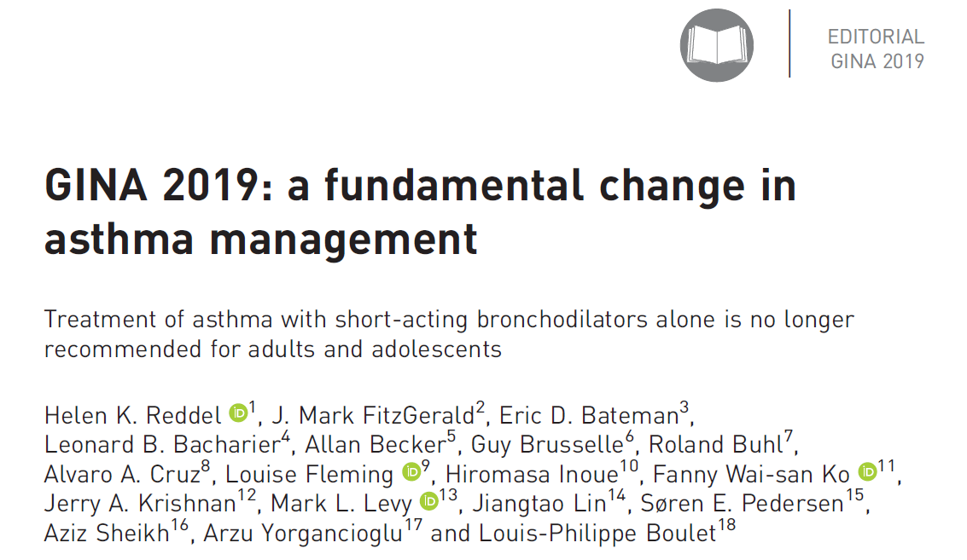

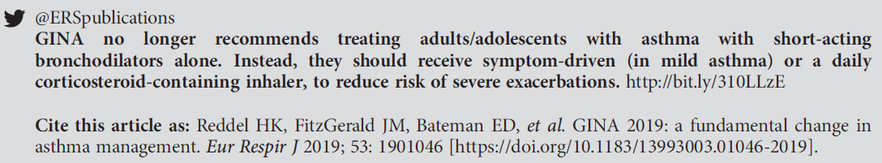
A reminder – the key change in GINA 2019

Slide 7
Background to changes in 2019 - the risks of ‘mild’ asthma
Patients with apparently mild asthma are at risk of serious adverse events
30–37% of adults with acute asthma
16% of patients with near-fatal asthma
15–20% of adults dying of asthma
Exacerbation triggers are variable (viruses, pollens, pollution, poor adherence)
Inhaled SABA has been first-line treatment for asthma for 50 years
This dates from an era when asthma was thought to be a disease of bronchoconstriction
Patient satisfaction with, and reliance on, SABA treatment is reinforced by its rapid relief of symptoms, its prominence in ED and hospital management of exacerbations, and low cost
Patients commonly believe that “My reliever gives me control over my asthma”, so they often don’t see the need for additional treatment
had symptoms less than weekly in previous 3 months (Dusser, Allergy 2007)
Notes:
Dusser D, Montani D, Chanez P, de Blic J, Delacourt C, Deschildre A, Devillier P, et al. Mild asthma: an expert review on epidemiology, clinical characteristics and treatment recommendations. Allergy 2007;62:591-604.
Reddel HK, Ampon RD, Sawyer SM, Peters MJ. Risks associated with managing asthma without a preventer: urgent healthcare, poor asthma control and over-the-counter reliever use in a cross-sectional population survey. BMJ open 2017;7:e016688.
Hancox RJ, Cowan JO, Flannery EM, Herbison GP, McLachlan CR, Taylor DR. Bronchodilator tolerance and rebound bronchoconstriction during regular inhaled beta-agonist treatment. Respir Med 2000;94:767-71.
Aldridge RE, Hancox RJ, Robin Taylor D, Cowan JO, Winn MC, Frampton CM, Town GI. Effects of terbutaline and budesonide on sputum cells and bronchial hyperresponsiveness in asthma. Am J Respir Crit Care Med 2000;161:1459-64.
Stanford RH, Shah MB, D’Souza AO, Dhamane AD, Schatz M. Short-acting β-agonist use and its ability to predict future asthma-related outcomes. Annals of Allergy, Asthma & Immunology 2012;109:403-7.
Suissa S, Ernst P, Boivin JF, Horwitz RI, Habbick B, Cockroft D, Blais L, et al. A cohort analysis of excess mortality in asthma and the use of inhaled beta-agonists. Am J Respir Crit Care Med 1994;149:604-10.

Slide 8
Background to changes in 2019 - the risks of SABA-only treatment
Regular or frequent use of SABA is associated with adverse effects
β-receptor downregulation, decreased bronchoprotection, rebound hyperresponsiveness, decreased bronchodilator response (Hancox, Respir Med 2000)
Increased allergic response, and increased eosinophilic airway inflammation (Aldridge, AJRCCM 2000)
Higher use of SABA is associated with adverse clinical outcomes
Dispensing of ≥3 canisters per year (average 1.7 puffs/day) is associated with higher risk of emergency department presentations (Stanford, AAAI 2012)
Dispensing of ≥12 canisters per year is associated with higher risk of death (Suissa, AJRCCM 1994)
Notes:
Reddel HK, Ampon RD, Sawyer SM, Peters MJ. Risks associated with managing asthma without a preventer: urgent healthcare, poor asthma control and over-the-counter reliever use in a cross-sectional population survey. BMJ open 2017;7:e016688.
Hancox RJ, Cowan JO, Flannery EM, Herbison GP, McLachlan CR, Taylor DR. Bronchodilator tolerance and rebound bronchoconstriction during regular inhaled beta-agonist treatment. Respir Med 2000;94:767-71.
Aldridge RE, Hancox RJ, Robin Taylor D, Cowan JO, Winn MC, Frampton CM, Town GI. Effects of terbutaline and budesonide on sputum cells and bronchial hyperresponsiveness in asthma. Am J Respir Crit Care Med 2000;161:1459-64.
Stanford RH, Shah MB, D’Souza AO, Dhamane AD, Schatz M. Short-acting β-agonist use and its ability to predict future asthma-related outcomes. Annals of Allergy, Asthma & Immunology 2012;109:403-7.
Suissa S, Ernst P, Boivin JF, Horwitz RI, Habbick B, Cockroft D, Blais L, et al. A cohort analysis of excess mortality in asthma and the use of inhaled beta-agonists. Am J Respir Crit Care Med 1994;149:604-10.

Slide 9
The 12-year history behind changes in GINA 2019
Since 2007, GINA has been actively seeking interventions for mild asthma
to reduce the risk of asthma-related exacerbations and death
to provide consistent messaging about the goals of asthma treatment, including prevention of exacerbations, across the spectrum of asthma severity
to avoid establishing patient reliance on SABA early in the course of the disease
GINA emphasized poor adherence as a modifiable risk factor for exacerbations
When the reliever is SABA, poor adherence with maintenance controller exposes the patient to risks of SABA-only treatment
GINA members repeatedly sought funding for RCTs of as-needed ICS-formoterol for risk reduction in mild asthma
Eventually culminated in 2014 with the initiation of the SYGMA studies, published in 2018 (O’Byrne NEJMed 2018; Bateman NEJMed 2018)
Notes:
Four GINA members (O’Byrne, Bateman, FitzGerald, Reddel) sought funding from AstraZeneca, Chiesi, and government agencies. Depending on the context of the presentation, you may want to explain that, although GINA’s focus was on risk reduction, the regulator required the primary outcome for SYGMA 1 to be a ‘control’ measure that would be relevant to all patients. The measure that was used (electronically recorded well-controlled asthma weeks, eWCAW) was systematically biased against the ICS-formoterol arm; a patient in the ICS group could take 14 doses of ICS in a week and still be counted as having a well-controlled week, whereas if a patient in the budesonide-formoterol arm took 5 doses of ICS-formoterol in a week, the week was automatically counted as not well-controlled.

Slide 10
GINA 2019 – landmark changes in asthma management
For safety, GINA no longer recommends SABA-only treatment for Step 1
This decision was based on evidence that SABA-only treatment increases the risk of severe exacerbations, and that adding any ICS significantly reduces the risk
GINA now recommends that all adults and adolescents with asthma should receive ICS-containing controller treatment, to reduce the risk of serious exacerbations
The ICS can be delivered by regular daily treatment or, in mild asthma, by as-needed low dose ICS-formoterol
This is a population-level risk reduction strategy
Other examples: statins, anti-hypertensives
Individual patients may not necessarily experience (or be aware of) short-term clinical benefit
The aim is to reduce the probability of serious adverse outcomes at a population level

Slide 11
The main GINA treatment figure
Personalized asthma management: Assess – Adjust – Review response
NOT just medications, NOT one-size-fits-all
No changes from 2019 in preferred and ‘other’ treatment options
Additional supporting evidence for recommendations in Steps 1 and 2
Some formatting changes for clarity
Separate figures for adults/adolescents, children 6–11 years and children ≤5 years
For children ≤5 years, see Chapter 6 of main GINA report

Slide 12
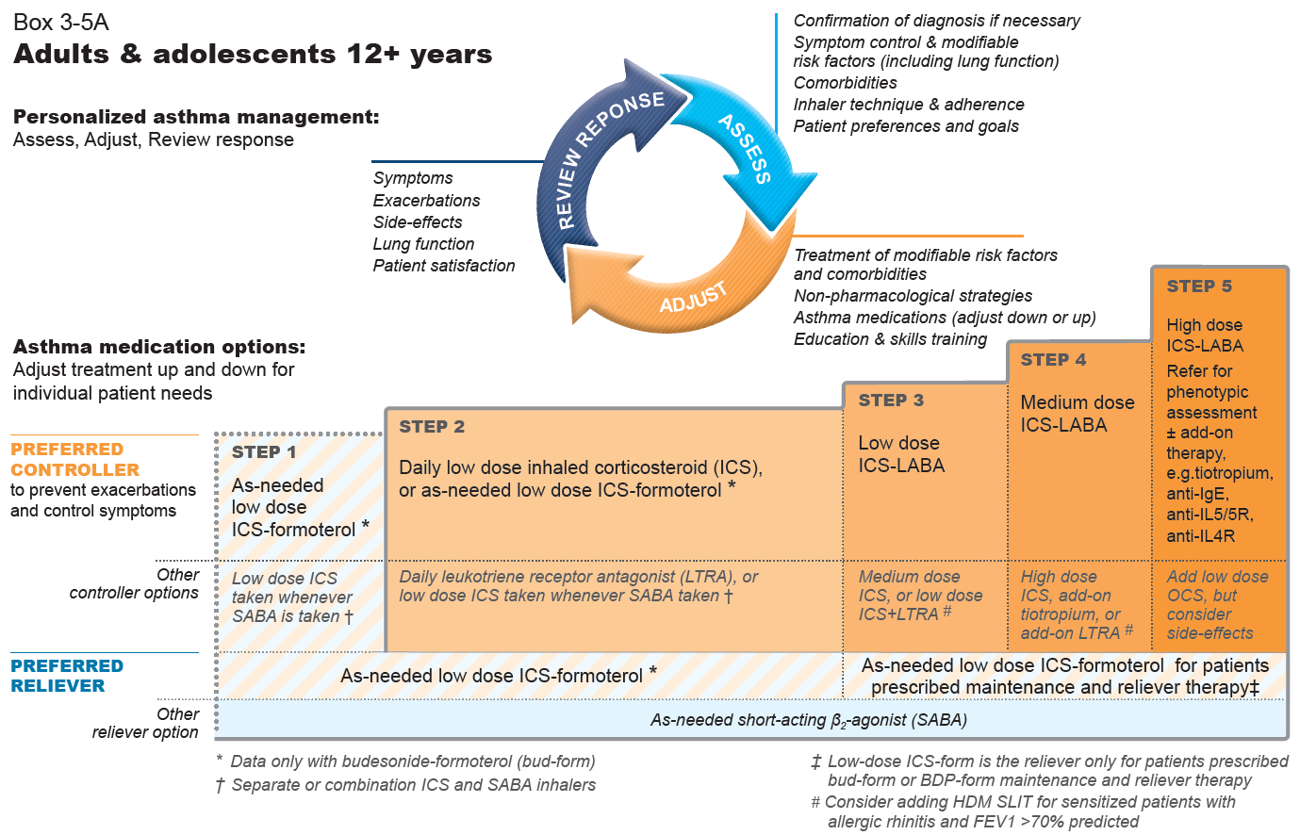
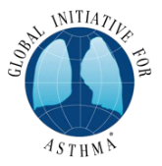
GINA 2020, Box 3-5A
Notes:
The only changes in this figure from the 2019 report are (in the arrowed circle) addition of patient preferences in the Assess section and addition of “adjust down or up” in the “Adjust” section, and removal of “off-label”. There are also some formatting changes to improve readability

Slide 13
ICS-formoterol is the preferred reliever for patients prescribed maintenance and reliever therapy. For other ICS-LABAs, the reliever is SABA
GINA 2020, Box 3-5A
Notes:
In the first version of this figure, published in April 2019, the qualifier about as-needed low dose ICS-formoterol being preferred reliever for patients prescribed maintenance and reliever therapy in Steps 3-5 was in the footnote immediately below. This wording was also added to the figure itself in June 2019 once we became aware that the footnote was sometimes being overlooked.

Slide 14
Additional supporting evidence
Two additional RCTs of as-needed low dose budesonide-formoterol in mild asthma
12-month studies, open-label, no twice-daily placebo, i.e. the way it would be used in real life
Novel START (Beasley et al, NEJM 2019, n=668) and PRACTICAL (Hardy et al, Lancet 2019, independent study, n=885)
Significant reduction in severe exacerbations vs SABA alone, and vs maintenance ICS, with small or no difference in symptom control, and lower average ICS dose
Patients in RCTs of this regimen in mild asthma now total n=9,565
Both of these studies included inflammatory markers
FeNO was significantly reduced by as-needed ICS-formoterol (with average 3-5 doses per week)
Reduction in risk of severe exacerbations with as-needed ICS-formoterol was independent of baseline characteristics, including blood eosinophils and exhaled nitric oxide
An additional RCT of taking ICS whenever SABA is taken (separate inhalers)
ASIST, in African-American children 6-17 years with mild asthma, compared with physician-adjusted treatment (Sumino et al, JACI in Pract 2019, n=206)
Notes:
Beasley R, Holliday M, Reddel HK et al. Controlled trial of budesonide-formoterol as needed for mild asthma. N Engl J Med 2019; 380: 2020-2030
Hardy J et al, and Reddel HK et al. Budesonide-formoterol reliever therapy vs maintenance budesonide plus terbutaline reliever therapy in adults with mild to moderate asthma: the PRACTICAL study, an independent open-label randomised controlled trial. Lancet 2019; 394: 919-928.
Sumino K, Bacharier LB, Taylor J, Chadwick-Mansker K, Curtis V, Nash A, et al. A pragmatic trial of symptom-based inhaled corticosteroid use in African-American children with mild asthma. JACI in Practice. 2019. DOI 10.1016/j.jaip.2019.06.030

Slide 15
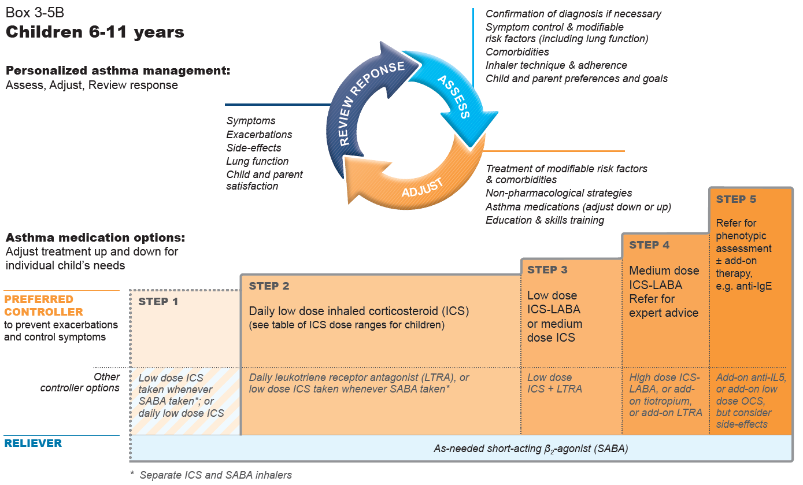
GINA 2020, Box 3-5B
Notes:
The only changes in this figure from the 2019 report are (in the arrowed circle) addition of preferences in the Assess section and addition of “adjust down or up” in the “Adjust” section, removal of “off-label”, and removal of “only one study in children” from the asterisked footnote. There are also some formatting changes to improve readability

Slide 16
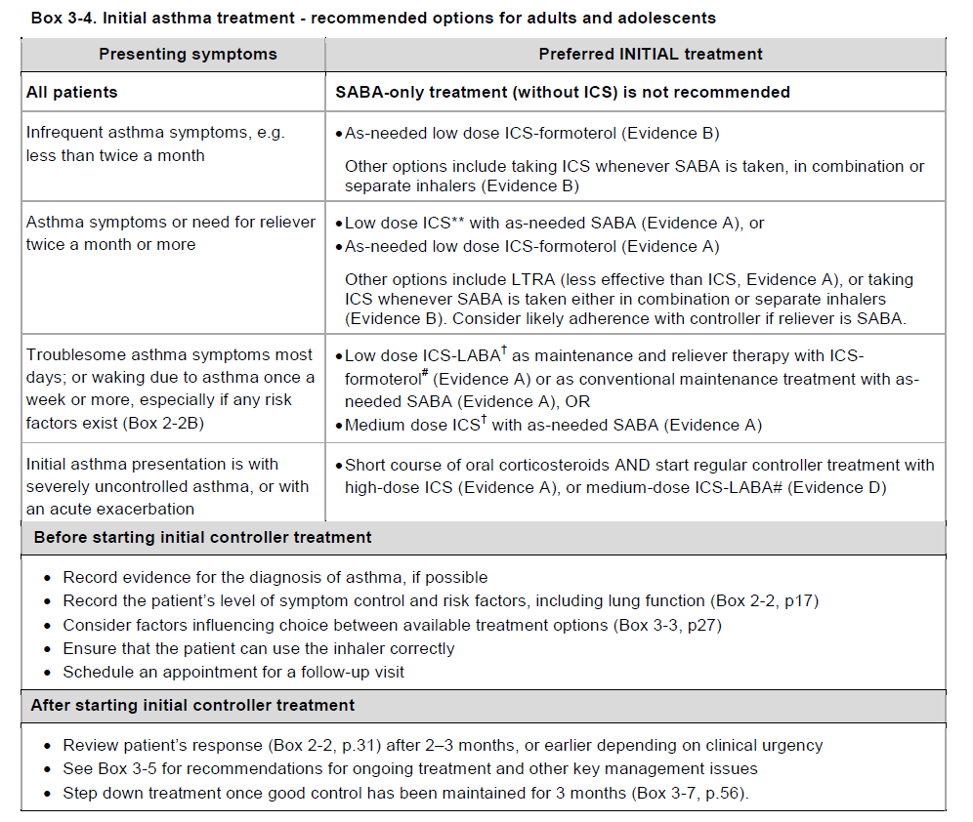
Initial asthma treatment – where to start?
Should all patients start at Step 1?
Table about initial treatment since 2014, but not widely known
New figures created (two versions)
Box 3-4, GINA 2019
GINA 2019, Box 3-4
Notes:
Explain that this information was in a table in previous GINA reports (Box 3-4) but the table was not widely known

Slide 17
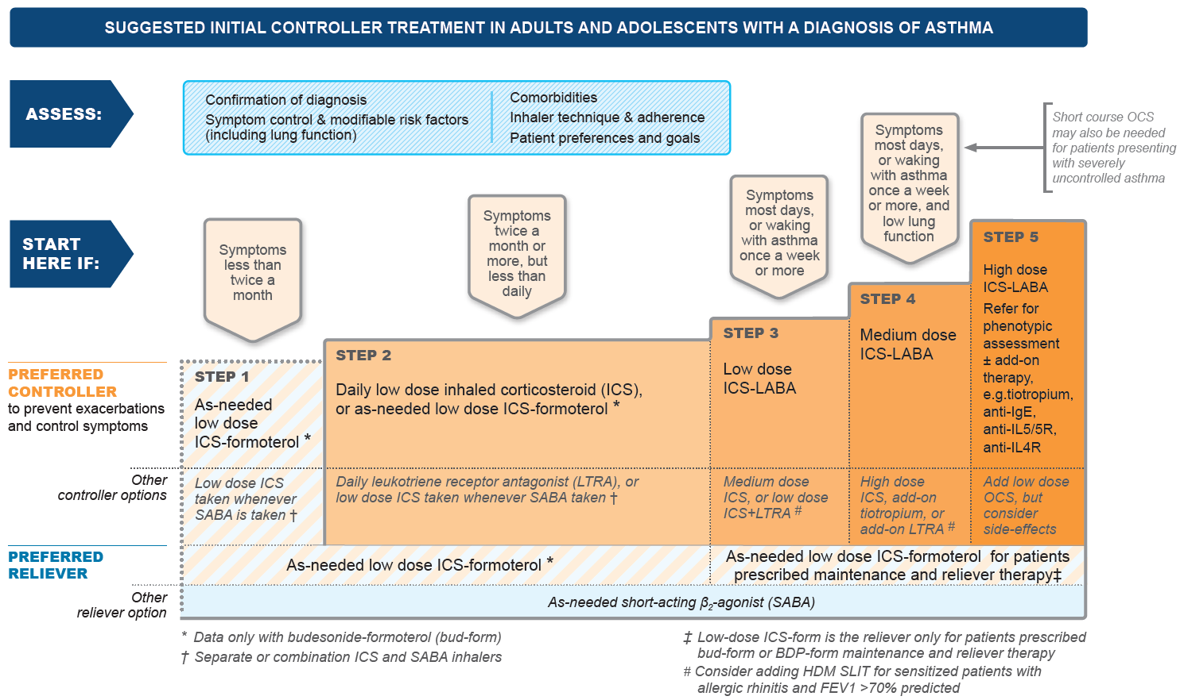
GINA 2020, Box 3-4A
Notes:
Explain that, once initial treatment is started, it is important to revert to the main treatment figure for the prompts in the arrowed circle (Assess, Adjust, Review response). Treatment is not just about pharmacotherapy

Slide 18
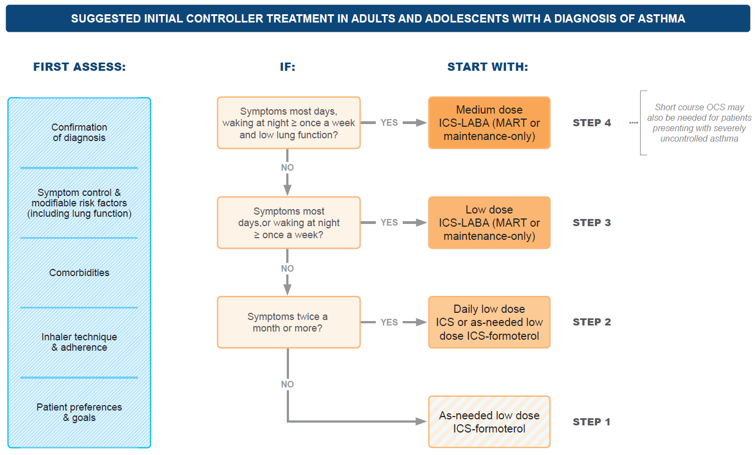
GINA 2020, Box 3-4B
Notes:
An alternative figure to Box 3-4A for teaching purposes, if audiences are not familiar with the GINA treatment figure

Slide 19
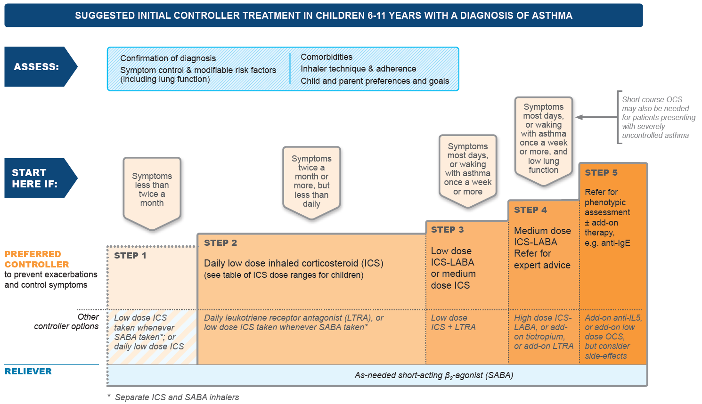
GINA 2020, Box 3-4C
Notes:
Explain that, once initial treatment is started, it is important to revert to the main treatment figure for the prompts in the arrowed circle (Assess, Adjust, Review response). Treatment is not just about pharmacotherapy

Slide 20
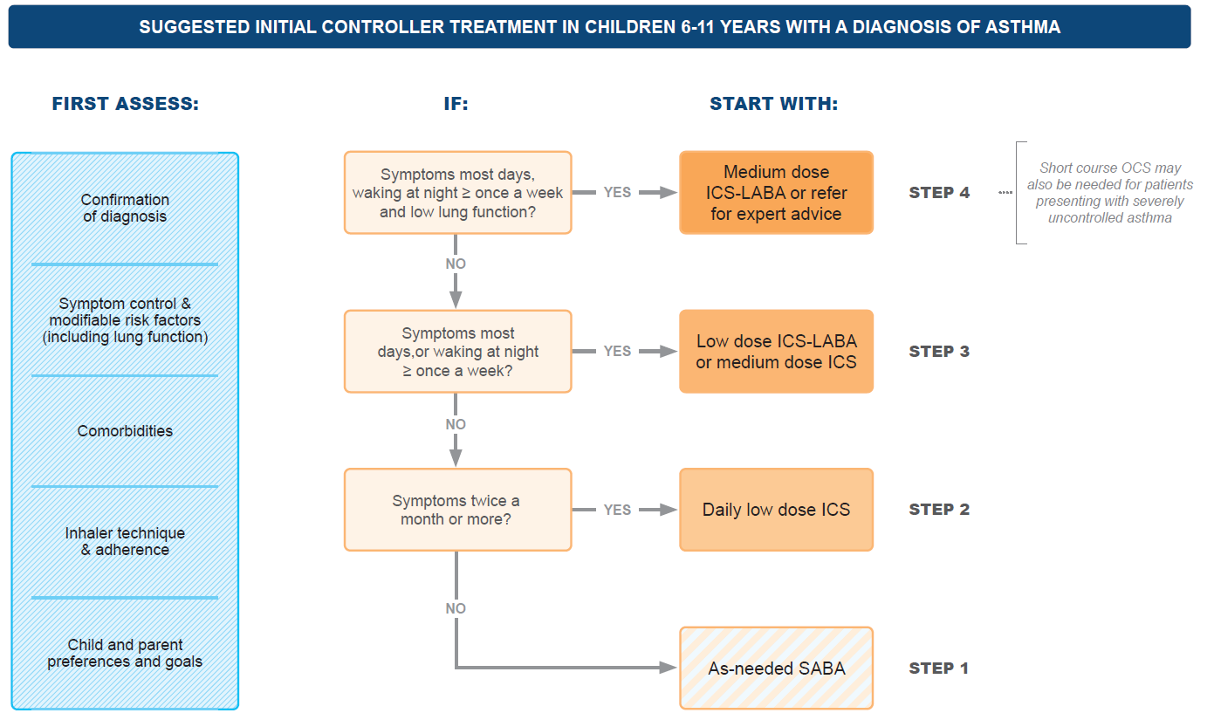
GINA 2020, Box 3-4D
Notes:
An alternative figure to Box 3-4C for teaching purposes, if audiences are not familiar with the GINA treatment figure

Slide 21
As-needed ICS-formoterol – maximum daily dose?
As-needed low dose budesonide-formoterol
Prescribed in maintenance and reliever therapy (Steps 3–5), or as-needed only (Steps 1–2), or within an asthma action plan
From product information, the maximum recommended total in one day is 72 mcg formoterol (12 inhalations of budesonide-formoterol Turbuhaler 200/6 mcg)
As-needed low dose beclometasone-formoterol
Prescribed in maintenance and reliever therapy (Steps 3–5), or within an asthma action plan
From product information, the maximum recommended total in one day is 48 mcg formoterol (6 inhalations of beclometasone-formoterol pMDI100/6 mcg)

Slide 22
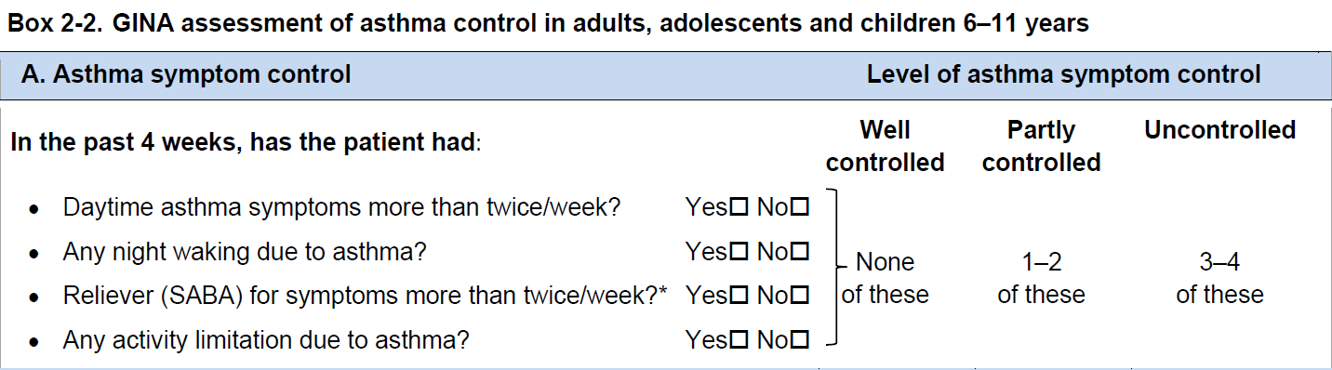
Assessment of symptom control
Frequency of SABA use is included in symptom control assessment
Higher SABA use is associated with worse outcomes, even in patients taking ICS
Our current view is that frequency of ICS-formoterol use should not be included in symptom control assessment, particularly in patients not taking maintenance ICS
The as-needed ICS-formoterol is providing the patient’s controller therapy
Further data awaited: this issue will be reviewed again next year
GINA 2020, Box 2-2A

Slide 23
Low, medium and high doses of different ICS
NOT a table of equivalence
Suggested total daily doses for ‘low’, ‘medium’ and ‘high’ dose treatment options
Based on available studies (very few) and product information
Does NOT imply potency equivalence
Doses may be country-specific depending on local availability, regulatory labelling and clinical guidelines
Clinical relevance
Low dose ICS provides most of the clinical benefit of ICS for most patients with asthma
However, ICS responsiveness varies between patients, so some patients may need medium dose ICS if their asthma is uncontrolled despite good adherence and correct technique
High dose ICS (in combination with LABA or separately) is needed by very few patients
Its long-term use is associated with an increased risk of local and systemic side-effects, which must be balanced against the potential benefits

Slide 24
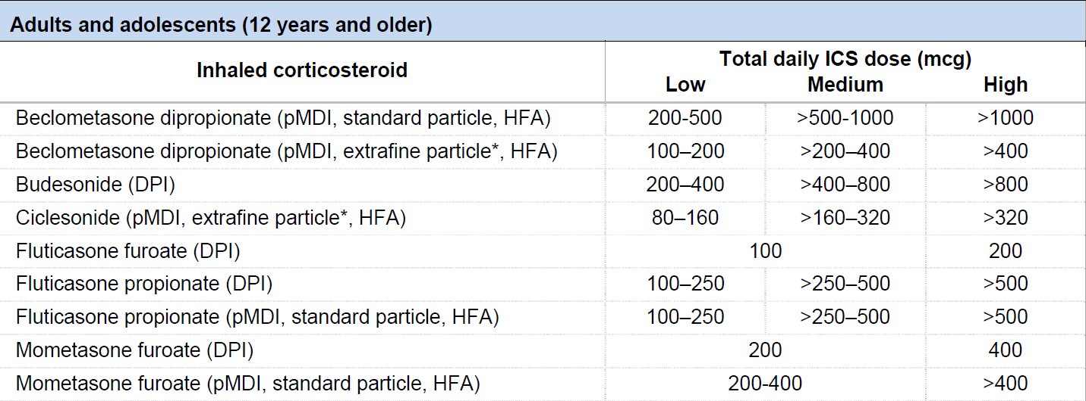
Low, medium and high ICS doses: adults/adolescents
This is NOT a table of equivalence. These are suggested total daily doses for the ‘low’, ‘medium’ and ‘high’ dose treatment options with different ICS.
DPI: dry powder inhaler; HFA: hydrofluoroalkane propellant; pMDI: pressurized metered dose inhaler (non-CFC); * see product information
GINA 2020, Box 3-6A

Slide 25
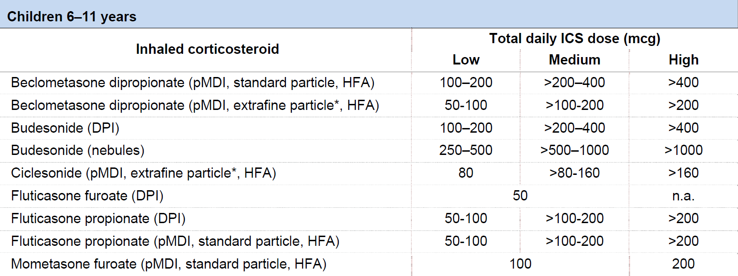
Low, medium and high ICS doses: children 6-11 years
This is NOT a table of equivalence. These are suggested total daily doses for the ‘low’, ‘medium’ and ‘high’ dose treatment options with different ICS.
DPI: dry powder inhaler; HFA: hydrofluoroalkane propellant; pMDI: pressurized metered dose inhaler (non-CFC); * see product information
GINA 2020, Box 3-6B

Slide 26
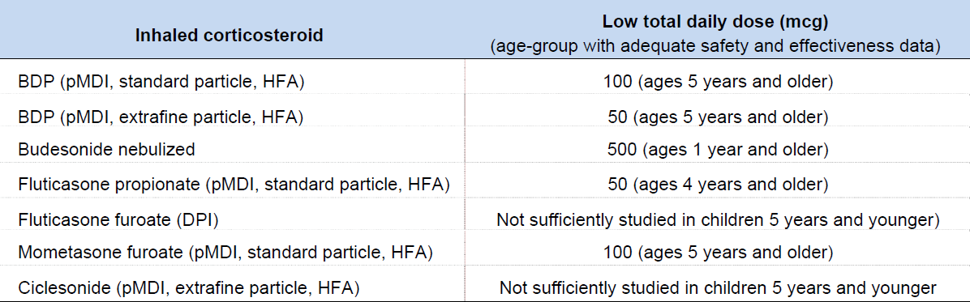
Low, medium and high ICS doses: children 5 years and younger
This is NOT a table of equivalence. These are suggested total daily doses for the ‘low’ dose treatment options with different ICS.
BDP: beclometasone dipropionate; DPI: dry powder inhaler; HFA: hydrofluoroalkane propellant; pMDI: pressurized metered dose inhaler (non-CFC)
GINA 2020, Box 3-6B

Slide 27
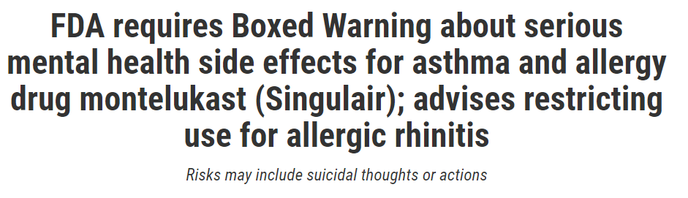
Adverse effects with montelukast
FDA boxed warning in March 2020 about risk of serious neuropsychiatric events, including suicidality, with montelukast
Includes suicidality in adults and adolescents
Nightmares and behavioral problems in children
Before prescribing montelukast, health professionals should consider its benefits and risks, and patients should be counselled about the risk of neuropsychiatric events

Slide 28
Asthma management in children
School-based programs that included asthma self-management are associated with improved asthma outcomes (Kneale et al, Thorax 2019)
Fewer emergency department visits
Fewer hospitalizations
Fewer days of reduced activity
Severe eosinophilic asthma in children aged 6-11 years
Mepolizumab approved by European Medicines Agency for this age-group (already approved for 12 years and older)
Efficacy data are limited to one small uncontrolled open-label study (Gupta et al, JACI 2019)
Children aged 5 years and younger
Assessment of severe exacerbations updated: respiratory rate >40/min added; pulse rate criteria modified; sub-glottic/sub-sternal retractions removed as too subjective

Slide 29
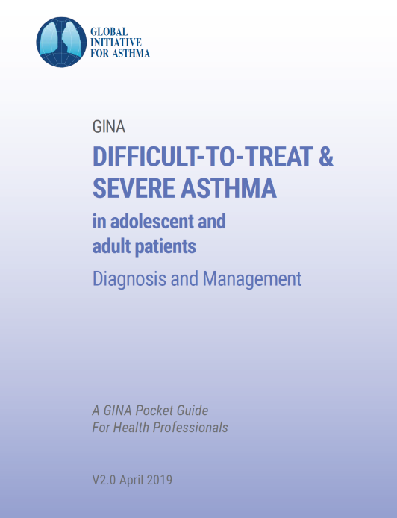
Difficult-to-treat and severe asthma
Pocket guide v2.0 published April 2019
A practical guide for primary and specialist care
Includes a decision tree about assessment and management of adults and adolescents with uncontrolled asthma or exacerbations despite Step 4-5 treatment
Includes strategies for clinical settings in which biologic therapy is not available or affordable
Content also included in full GINA 2020 report
Aim is to produce a similar pocket guide for children in 2020

Slide 30
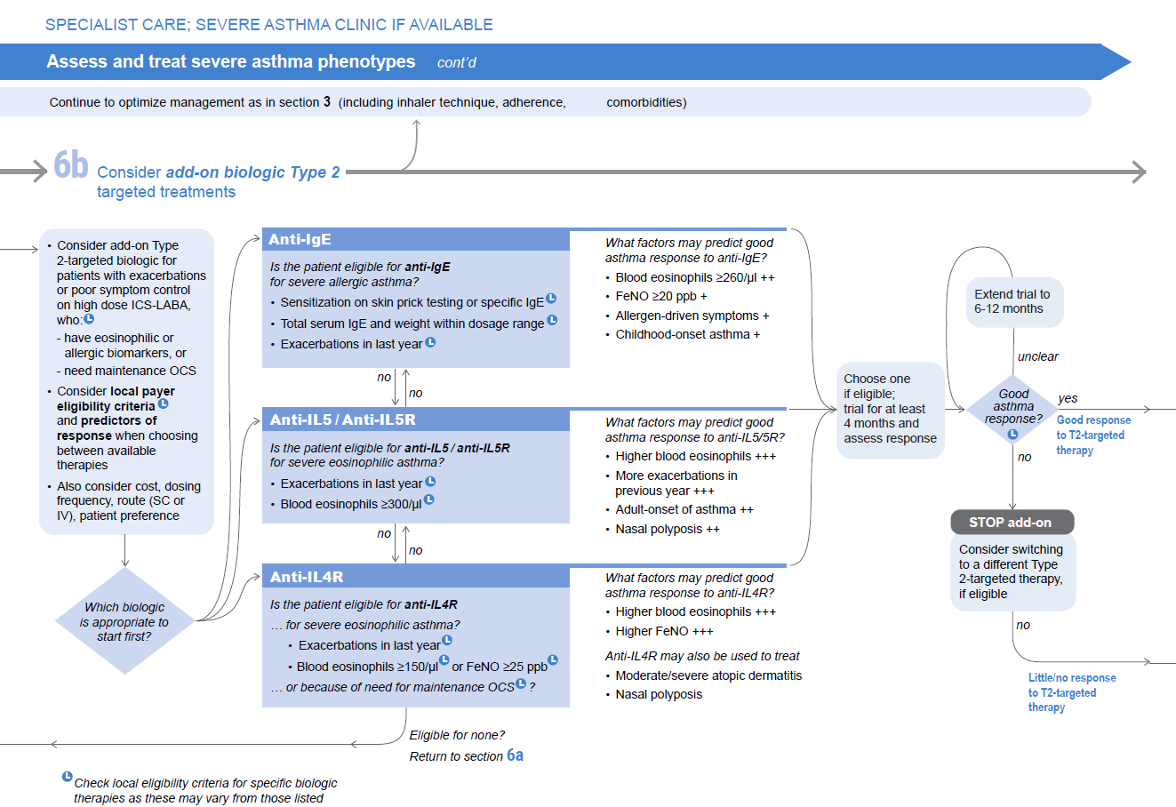
Notes:
This slide shows a page from the decision tree in v2.0 pocket guide – addition of dupilumab, and of prompt for extension of treatment trial if response is unclear

Slide 31
Patients with features of asthma and COPD
Also called ‘asthma-COPD overlap’ or ‘asthma+COPD’
NOT a single disease, but a descriptive label for patients commonly seen in clinical practice
Asthma and COPD are heterogeneous and overlapping conditions
The definitions of asthma and COPD are not mutually exclusive
Each includes several phenotypes that are likely to have different underlying mechanisms
There is increasing interest in the potential for precision treatment
However, the labels ‘asthma’ and ‘COPD’ are still clinically important, as evidence supports safety-based differences in treatment recommendations
Asthma: never treat with bronchodilators alone (risk of death, hospitalization, severe exacerbations)
COPD: start treatment with LABA and/or LAMA without ICS
Patients with diagnoses of both asthma and COPD are more likely to die or be hospitalized if treated with LABA vs ICS-LABA (Gershon et al, JAMA 2014; Kendzerska et al, Annals ATS 2019)
High dose ICS may be needed for severe asthma, but should not be used in COPD (risk of pneumonia)
Chapter 5 has been rewritten for clinical utility, focusing on clinical recognition and safe initial treatment

Slide 32
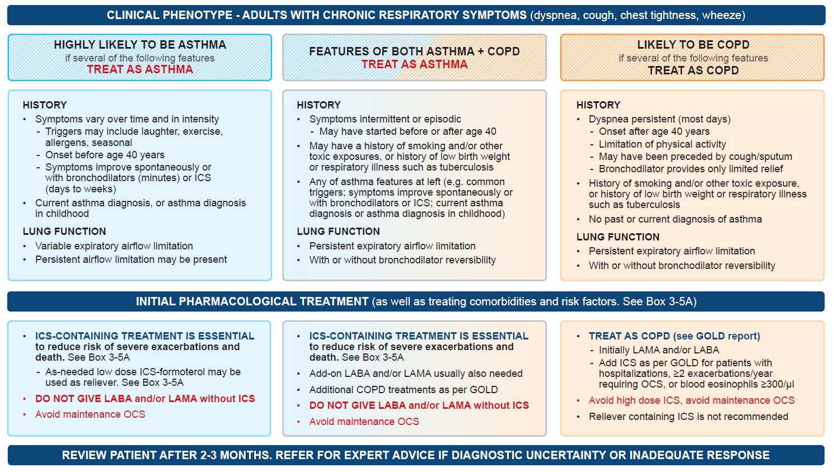
Patients with features of asthma and COPD
GINA 2020, Box 5-2

Slide 33
Other changes in GINA 2020
Acute asthma
References to ‘high flow oxygen’ have been corrected to ‘high concentration oxygen’
Role of trained lay health workers in asthma education has been emphasized
Improved outcomes compared with usual care including increased symptom-free days, reduced healthcare utilization, improved adherence, inhaler technique, symptom control and quality of life
Factors contributing to development of asthma
Obesity may be a risk factor for developing asthma (Deng et al, Pediatr Obes 2019), but not vice versa (Xu et al, Int J Epidemiol 2019)
13% of global asthma incidence in children may be attributable to traffic-related air pollution (Achakulwisut et al, Lancet Plan Health 2019)

Slide 34
GINA methodology – additional details
The GINA report is a global strategy document
Regulatory approvals and submissions differ from country to country
Many recommendations are ‘off-label’ in various countries, particularly for paediatrics
The term ‘off-label’ is no longer used in the GINA report or slides
For new therapies
Regulatory agencies often receive more safety data than are in peer-reviewed literature
GINA makes recommendations based on the best available evidence, after approval by at least one major regulatory agency (e.g. EMA, FDA)
For existing medications with evidence for new regimens or populations
If satisfied with evidence for safety and effectiveness, GINA may consider making recommendations that are not covered by a regulatory indication in any country at the time
Examples: long-term macrolides for moderate-severe asthma (2018); as-needed ICS-formoterol, or taking ICS whenever SABA is taken, for mild asthma (2019)
When assessing and treating patients
Use your own professional judgment
Take into account local and national guidelines and payer eligibility criteria, and licensed drug doses

Slide 35
Questions?

